Slide 1













MChem Consultants
Engineering Sustainable Solutions for a Better Tomorrow.
01
@bic.muet

Slide 2


MChem Consultants
02
@bic.muet

Slide 3
Introduction
Student-led. Faculty-guided. Industry-focused.
MChem Consultants is a student-led initiative at MUET Jamshoro, guided by experienced faculty, delivering innovative chemical engineering solutions to SMEs in Sindh's industrial zones.
We bridge the gap between textbook knowledge and real-world industrial problems.
Mission: Bridge academia and industry through affordable, high-impact engineering.
Vision: Become Pakistan's trusted partner for sustainable industrial solutions.
03
@bic.muet

Slide 4
Problem Statement
Three problems. One reality. Millions lost.
Inefficient processes: Aging infrastructure, legacy systems, and 15–20% material & energy waste.
Sustainability gaps: Lack of expertise to manage emissions, waste, and adopt green technologies.
Safety risks: Unidentified hazards, reactive safety protocols, and no predictive maintenance.
Result: Reduced profitability, low sustainability, and weak global competitiveness.
04
@bic.muet

Slide 5
Solution
Service | Impact
Process Modeling & Simulation | Optimize performance, reduce OPEX
Sustainable Engineering Audits | Cut waste, recover energy, lower emissions
Cost & Feasibility Studies | Ensure ROI before investing
Customized Training | Build in-house expertise
Why us?
Student-led = cheaper. Faculty-guided = quality assured.
Sustainability-first = future-ready.
We don’t just fix problems — we transform operations.
05
@bic.muet

Slide 6
Business Process Flow
┌─────────┐ ┌─────────┐ ┌─────────┐ ┌─────────┐ ┌─────────┐
│ Connect │→│ Diagnose │ →│ Simulate │→│ Solve │ → │ Support │
└─────────┘ └─────────┘ └─────────┘ └─────────┘ └─────────┘
│ │ │ │ │
▼ ▼ ▼ ▼ ▼
Industry Lab Audit Software Solution Implementation
Contact & Data Modeling Delivery & Training
Connect → Diagnose → Simulate → Solve → Support
Simple. Affordable. Effective.
We take your problem and hand you back savings.
06
@bic.muet

Slide 7
Customers and Marketing Strategy
Target Customers
Market Size
Market
🌍 TAM (Pakistan)
🎯 SAM (Within Sindh)
🚀 SOM (Year 1 - 10 factories)
Sector | Need
🛢️ Oil & Gas | Process optimization, energy efficiency, safety
🧪Chemicals | Waste minimization, regulatory compliance
👕 Textile | Effluent treatment, water management
Marketing Channels
Direct Visits
Our Promise
You don't need an expensive consultant. You need fresh eyes, guided by experience, at a price you can actually afford.
MUET Workshops
Trade Associations
LinkedIn and electronic media
Referrals
07
@bic.muet

Slide 8
Prototype / MVP
We've already proven it works.
What We Found
Our MVP Ethyl Acetate plant Study
Parameter | Before | After Optimization
Energy Consumption | High | 🔻 15% reduction
Raw Material Waste | Significant | 🔻 10% recovered
Reactor Conversion | 82% | 📈 92% achievable
Element | Details
Project | Ethyl Acetate Manufacturing Process
Tool Used | Aspen Hysys Simulation
Goal | Identify inefficiencies & optimize production
Status | ✅ Completed
Key Insight
The plant was operating below design capacity. Simple changes in reflux ratio and feed temperature could save millions annually.
08
@bic.muet

Slide 9
Milestones
If Funded
Software licenses → Full Aspen/AutoCAD access
Student stipends → Dedicated consulting team
Industry outreach → Regular factory visits
3 free pilots → Build case studies & trust
Past | Present | Future
Achieved
Team formed (MUET Chemical Engineering)
Faculty mentors on board
Software access: Aspen & AutoCAD
Ethyl Acetate plant simulation
Industry discussions: 1 factories
Concept proven. Team ready. Next stop: your factory.
09
@bic.muet

Slide 10
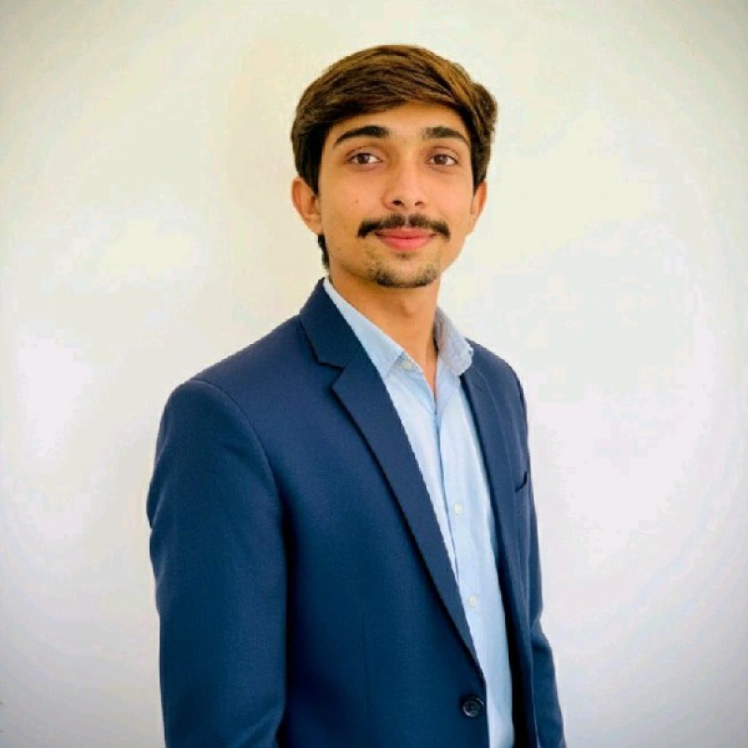
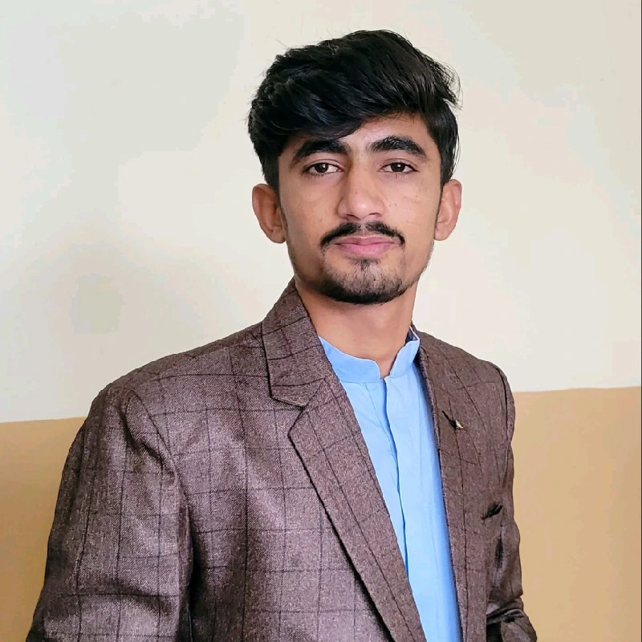
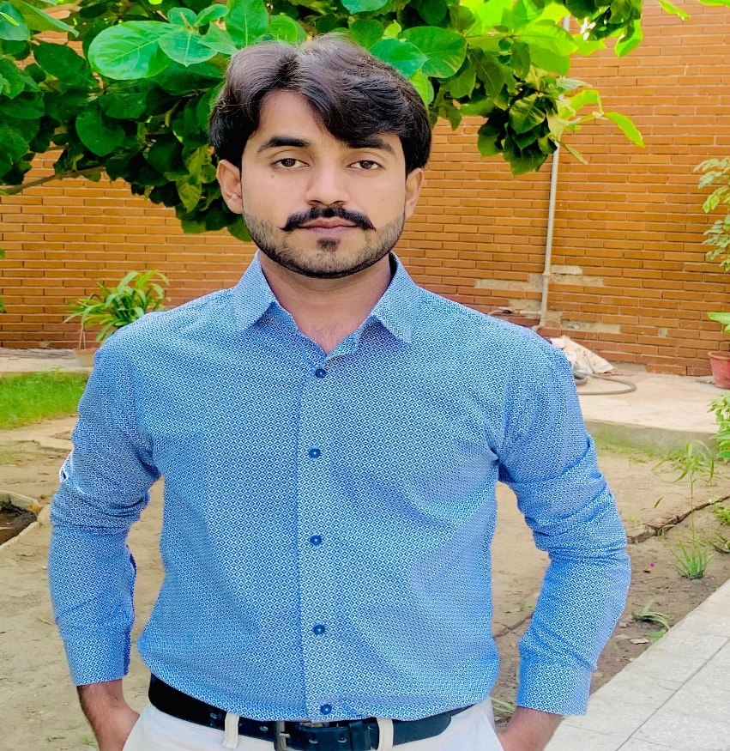
Team
The Dreamers & The Doers
We don't just work together. We believe together.
Muhsin Ali
Founder & COO
Process Lead, Industry Coordination, Operations Management
Sardar Ali
CTO & Co-Founder
Process Simulation, Technical Modeling, Software & Design
Muhammad Hassan
CFO & CMO
Financial Planning, Marketing Strategy, Client Acquisition
10
@bic.muet

Slide 11
Financials
Revenue Model
Year | Projects | Revenue
Year 1 | 10 | 20000
Year 2 | 18 | 36000
Year 3 | 25 | 50000
Stream | How It Works
Project-Based Consulting | Fixed fee per audit / simulation project
Training Programs | Paid workshops on safety, software, compliance
Based on 10 clients in Year 1, growing through referrals
Low overhead. University infrastructure keeps costs down.
High value. Clients pay less. We still win.
Affordable for them. Sustainable for us.
11
@bic.muet

Slide 12
Contact Details
Let's build something sustainable together.
Muhsin Ali
📧 Email
muhsinalisolangi12@gmail.com
📞 Phone
+92 315 3119212
📍 Address
Chemical Engineering Department
Mehran University of Engineering & Technology (MUET)
Jamshoro, Sindh, Pakistan
12
@bic.muet

